Slide 1
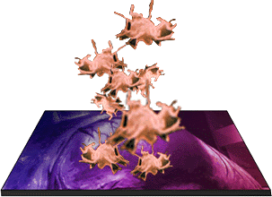
Thrombocytes and Coagulation
VTHT 2323
Clinical Pathology I
L. VanValkenburg, RVT

Slide 2
Thrombopoiesis
Platelet parent cell = Megakaryocyte
Thrombopoietin stimulates PPSCs to differentiate into megakaryoblasts.
As a megakaryocyte develops, nucleus divides but cytoplasm does not.
Result is a large, multinucleated cell with abundant cytoplasm.
Most megakaryocytes live in bone marrow, but some colonize lungs and produce platelets there.

Slide 3
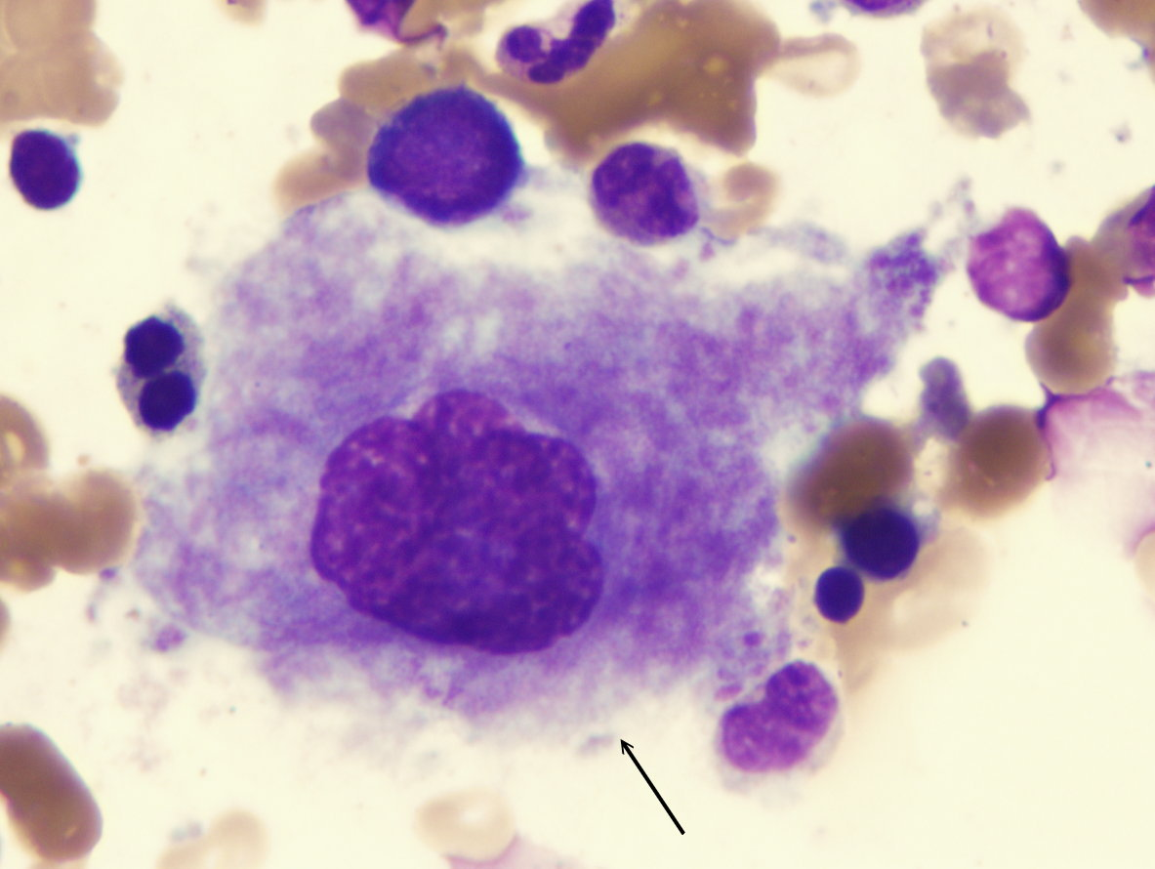
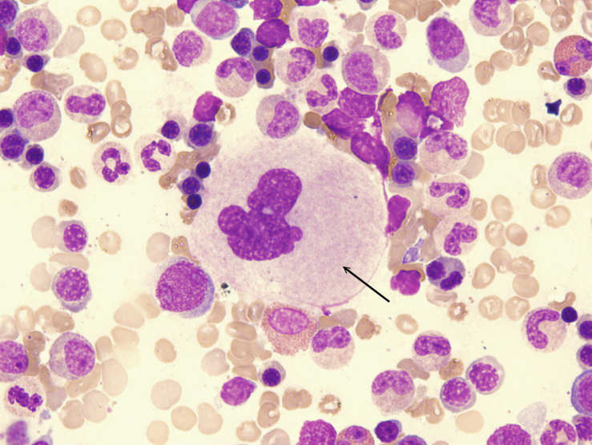
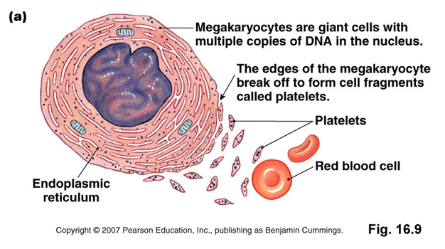
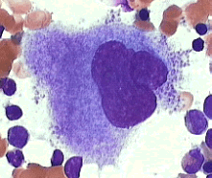
Megakaryocytes

Slide 4
Megakaryocytes
Infoldings develop into plasma membrane that divide marginal cytoplasm into little compartments which break off and enter bloodstream as platelets.
Some platelets are stored in spleen and released as needed.
Others circulate freely in the blood and live for about 5 - 8 days in dogs and just over 1 day in cats.

Slide 5
Megakaryocyte Video
http://www.youtube.com/watch?v=6R-ESPFiKbo&feature=related&ajax=1&nocache=1271011451258

Slide 6
Thrombocytes
Commonly referred to as platelets.
Not complete cells (lack a nucleus), but frequently listed as one of the cell types in peripheral blood.
RBCs>PLTs>WBCs
When activated, form pseudopods capable of ameboid movement.
Have a greater variety of functions than any of the true blood cells.

Slide 7
Thrombocyte Morphology
Most are smaller than RBCs
Most PLTs in circulation are round and have numerous, small, purple/pink granules scattered throughout the cytoplasm.
Occasionally giant platelets are seen in blood smear (considered more active than smaller platelets)

Slide 8
Normal Platelet Values
Canine: 200,000 – 500,000 /µL
Feline: 300,000 – 700,000 /µL
All species: 100,000 – 800,000 /µL
Horses = lowest normal concentrations
Cattle = highest normal concentrations
Animals will bleed spontaneously if PLT concentration is ≤ 10,000 to 50,000 /µL

Slide 9
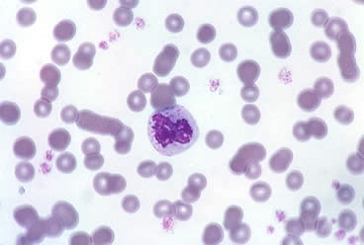
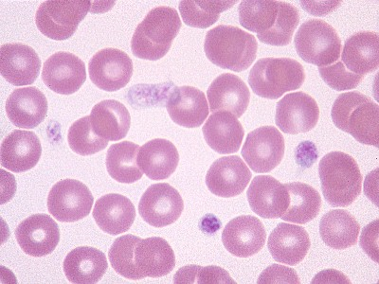
Normal Platelet Morphology
Feline
Canine

Slide 10
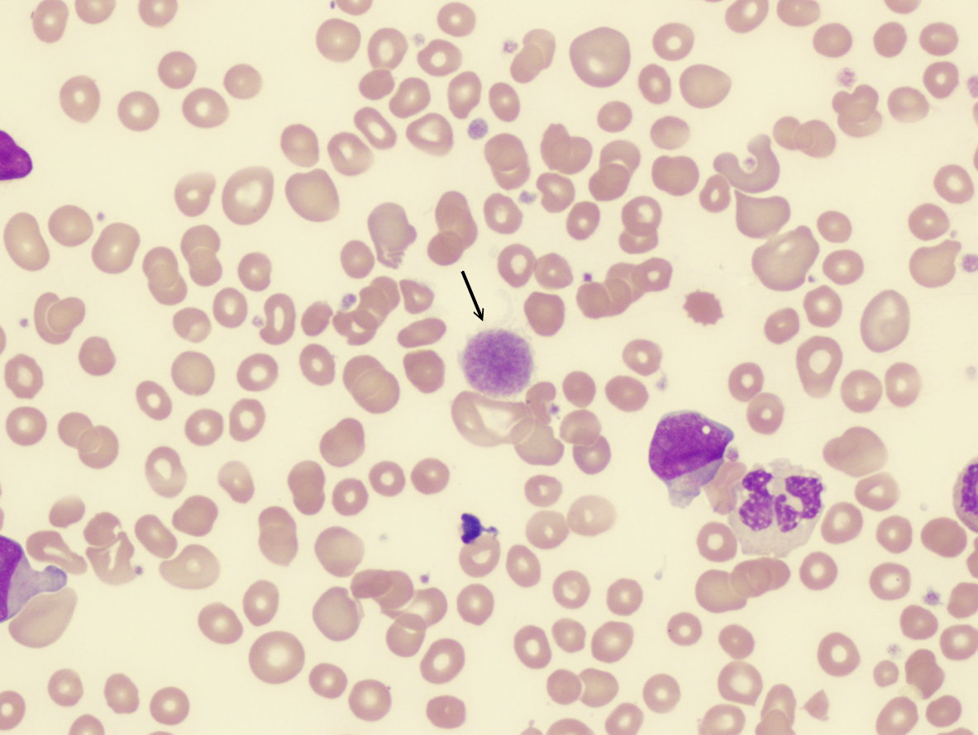
Giant Platelet in Peripheral Blood

Slide 11
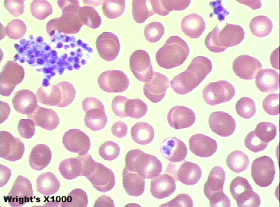
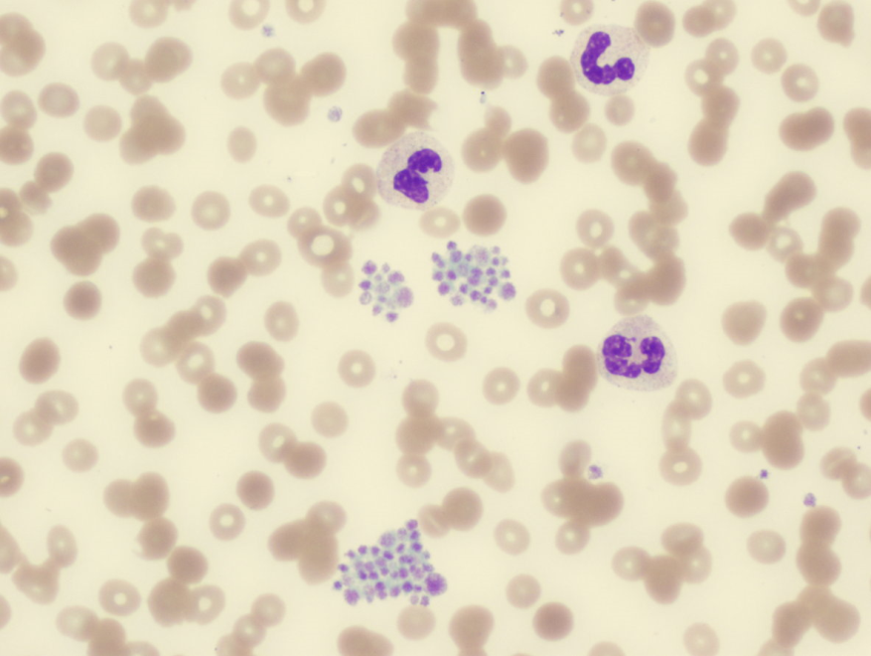
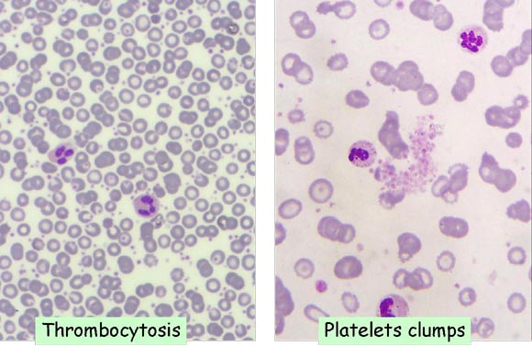
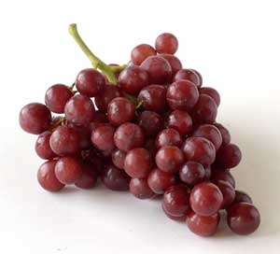
Platelet Clumping
Platelet Clumps
Thrombocytosis
Platelet Clumps

Slide 12
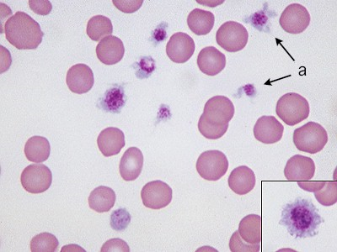
Normal Activated Platelets
Platelets that have been slightly activated in the sample or by contact with the glass slide (as is common in feline samples) have a stellate form with dendritic processes ("a" in figure). The inset shows a large platelet with centrally aggregated granules which resemble a nucleus.

Slide 13
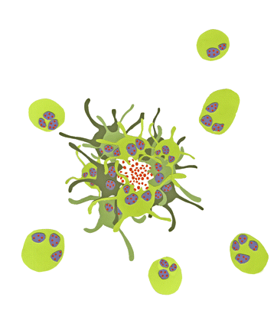
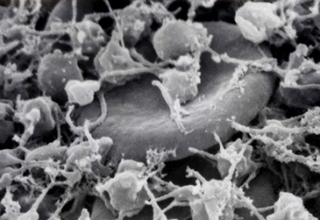
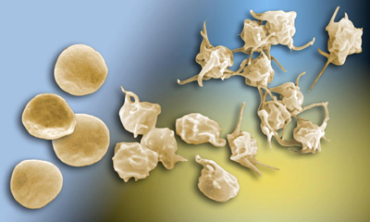
Activated Platelets

Slide 14

Platelet Make-up
The most important components of the platelet are:
Clotting factors (XII, XIII, PF₁, PF₂, PF₃, PF₄)
Calcium
Lysosomes
Mitochondria
*Platelets do not have a nucleus.

Slide 15
Functions of Platelets
Secrete vasoconstrictors
Form platelet plugs
Secrete procoagulants
Initiate dissolution of blood clots
Secrete chemicals that attract neutrophils and monocytes to sites of inflammation
Phagocytize and destroy bacteria
Secrete growth factors to help maintain and repair blood vessels

Slide 16
Hemostasis
Hemostasis is the process by which blood is prevented from leaking out of damaged blood vessels.
Three Roles of platelets in hemostasis:
Maintain vascular integrity
Platelet plug formation
Stabilization of hemostatic plug by contributing to the process of fibrin formation.

Slide 17
Stages of Hemostasis
Primary Hemostasis
  Vasoconstriction
  Primary platelet plug formation
    Platelet adhesion
    Platelet aggregation
Secondary Hemostasis
  Coagulation Cascade
    Ultimate goal = fibrin for stabilization of platelet plug
    Intrinsic, Extrinsic, and Common Pathways
Tertiary Hemostasis (Fibrinolysis)
  Clot retraction (occurs after ~30 mins.)
    Platelet Derived Growth Factor (PDGF) secreted to repair damage to all tissues involved.
  TPA → Plasminogen → Plasmin
    Clot initiates its own destruction

Slide 18
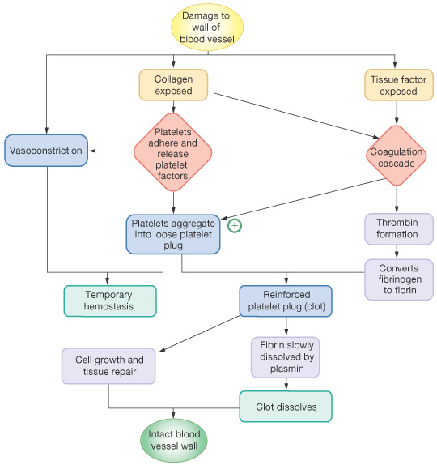
The Basics of Coagulation

Slide 19
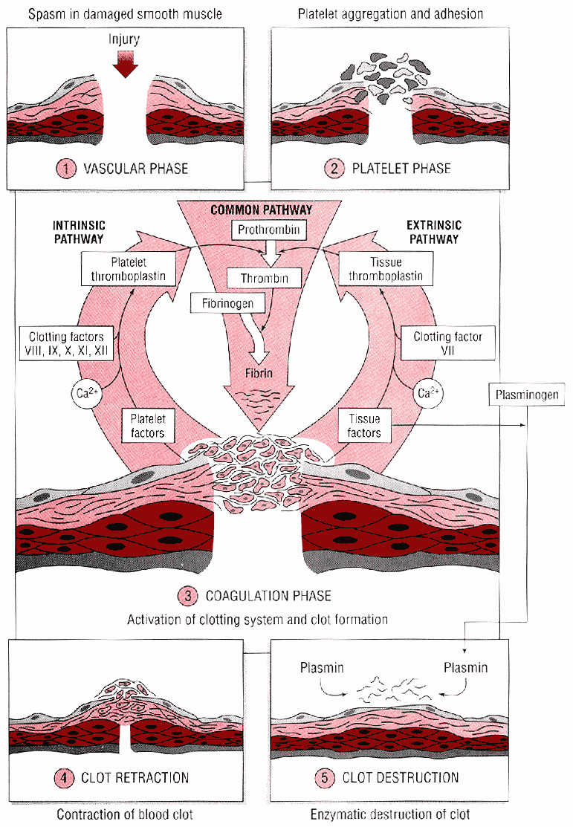
Clot Formation Video
http://www.youtube.com/watch?v=--bZUeb83uU

Slide 20
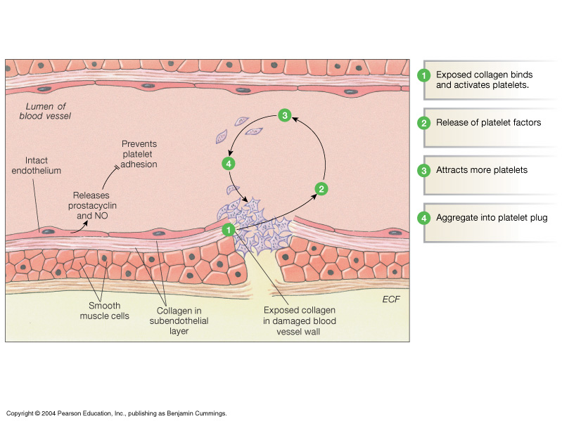
Platelet Plug Formation
Figure 16-12: Platelet plug formation

Slide 21
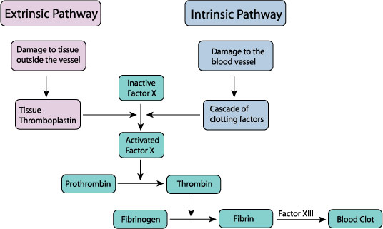
Coagulation Simplified
Extrinsic Clotting Mechanism
  chemical outside of blood triggers blood coagulation
  triggered by thromboplastin (not found in blood)
  triggered when blood contacts damaged tissue
Intrinsic Clotting Mechanism
  chemical inside blood triggers blood coagulation
  triggered by Hageman factor (found inside blood)
  triggered when blood contacts a foreign surface

Slide 22
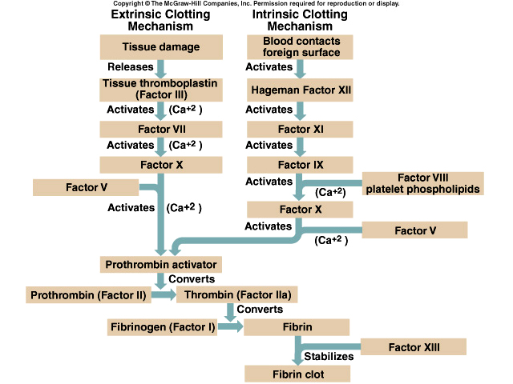
The Coagulation Cascade

Slide 23
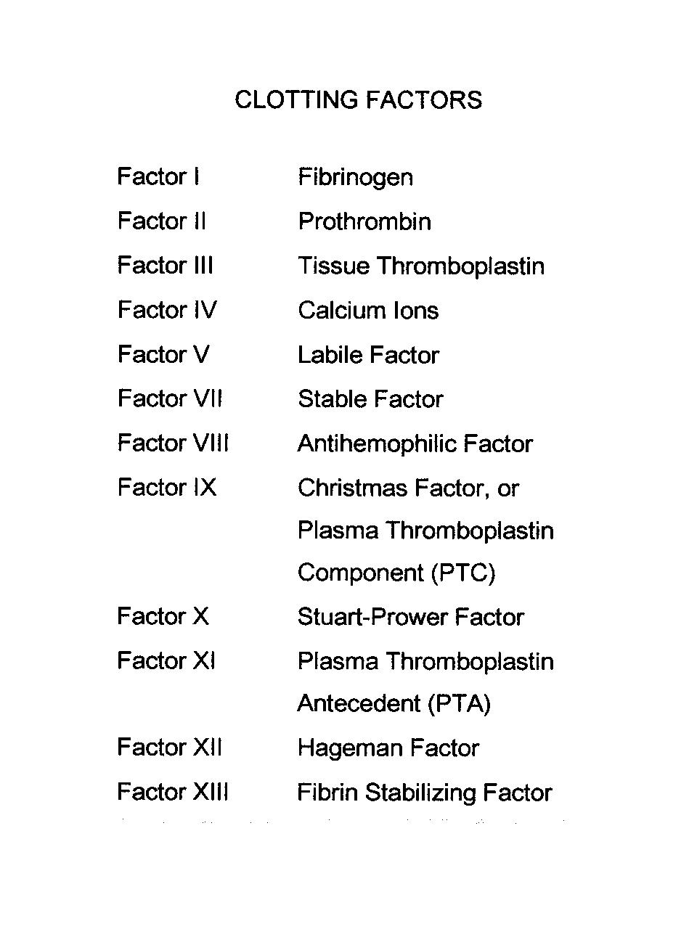
Foolish People Try Climbing Long Slopes After Christmas.
Some People Have Fallen.

Slide 24
Hemostasis Testing
Samples should be collected very carefully with minimal tissue damage.
Never collect sample through indwelling catheters.
Anticoagulant of choice = Sodium citrate
  Blocks calcium (but not as strongly as EDTA)
  Blue top tube (a.k.a – turquoise)
  Be sure to maintain (9:1) blood : anticoagulant ratio
Results of some testing affected by stress, illness, recent exercise, heat cycle (females)
Note: Heparin prevents conversion of prothrombin to thrombin during coagulation.

Slide 25
Clotting Tests
Assess one or more of the phases of hemostasis (primary, secondary or tertiary)
Tests involving secondary hemostasis assess intrinsic, extrinsic and/or common pathways.
All patients should undergo coagulation testing prior to undergoing a surgical procedure.
    Platelet estimation
    Buccal mucosal bleeding time
    Activated clotting time (ACT)
    Prothrombin time (PT)
    Partial thromboplastin time (PTT)
    Fibrinogen assay

Slide 26
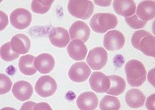
Platelet Counting Methods
Manual or Automated (least accurate)
Most inaccuracies attributable to
  Aggregation, giant platelets, RBC overlap
Always use fresh sample to minimize error
Manual methods:
  Unopette system & hemocytometer
    Count 25 small squares within “supersquare” of grid
    Multiply number counted by 1000 to calculate #/µL
    Count PLTs after WBCs (takes ~10 mins. to settle)
  Platelet estimation during blood film analysis
    Estimated number of PLTs in 10 fields x 20,000 or
    Count PLTs out of 100 WBCs during differential and calculate absolute number of total WBC count
    ALWAYS USE HIGH POWER, OIL IMMERSION!

Slide 27
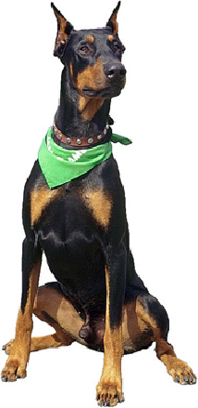
Buccal mucosal bleeding time
Tests primary hemostasis
platelet function & number (thrombocytopathy, thrombocytopenia)
endothelial cell function (von Willebrand’s disease)
Test can be affected by certain NSAIDs

Slide 28
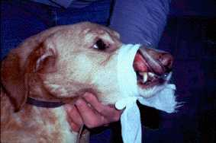
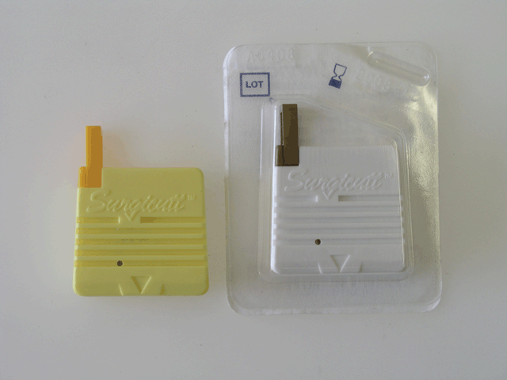
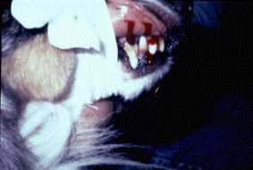
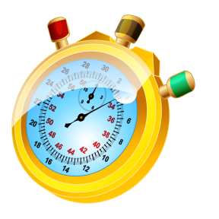
Buccal mucosal bleeding time

Slide 29
BMBT Procedure
Place anesthetized animal in lateral recumbency.
Use a strip of gauze to tie upper lip back and expose mucosal surface.
Using a Surgicutt® or a Simplate® lancet, create a small wound (~1 mm deep)
Remove blood with filter paper at 30-second intervals DO NOT TOUCH SKIN
Stop timing when there is no more blood.
Normal = 1-5 minutes (canine/feline)

Slide 30
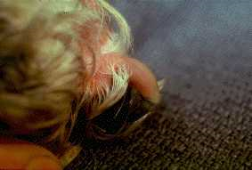
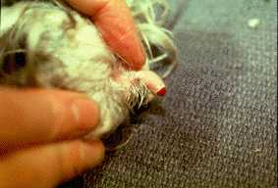
Toenail Bleeding Time
An alternative to BMBT
Clip toenail just past quick to cause bleeding
Keeping animal undisturbed, monitor for bleeding to cease
Normal = <5 minutes (canine/feline)

Slide 31
Activated Clotting Time (ACT)
Evaluates secondary hemostasis (all factors except Factor VII)
Requires Vacutainer containing sterile diatomaceous earth to activate coagulation pathways
  Blood is collected directly into tube
  It is important that tube is pre-warmed and kept at 37º C.
Test can be affected by significantly low platelet numbers
Normal = 60 – 90 seconds (canine/feline)

Slide 32
Prothrombin Time (PT)
Evaluates adequacy of factors associated with extrinsic and common pathways
Factor XIII activity not evaluated
Platelet substitue added to sample (thrombocytopenia does not interfere)
Normal: Canine = 6.4 - 7.4 seconds;
Feline = 7 - 11.5 seconds

Slide 33
Partial Thromboplastin Time (PTT)
Evaluates adequacy of factors associated with the intrinsic and commmon pathways
Factor XIII activity not evaluated
Platelet substitute added
Normal: Canine = 9-11 seconds;
Feline = 10-15 seconds

Slide 34
Fibrinogen Assay
Can be done by manual or automated methods
Only evaluates fibrinogen concentration
Can use EDTA anticoagulated sample
Concentrations may be increased during inflammation or decreased when consumed during coagulation (DIC)
Normal: Canine = 100 – 250 mg/dL
Feline = 100 – 350 mg/dL

Slide 35
Manual Fibrinogen Concentration Determination Procedure
Centrifuge two microhematocrit tubes
Determine TP of tube 1
Incubate tube 2 in water bath at 58º C for 3 minutes then recentrifuge.
Determine TP (g/dL) of tube 2 then multiply by 1000 to obtain concentration (TS = total solids) in mg/dL
Use the following equation to calculate fibrinogen concentration:
TS mg/dL _{(non-incubated)} – TS mg/dL _{(incubated)} = Fibrinogen mg/dL

Slide 36
Other Coagulation Tests
Whole Blood Clotting time
Clot Retraction Test
One-Stage Prothrombin Time (OSPT)
  Used to confirm warfarin toxicity (rodenticide)
Activated Partial Thromboplastin Time (APTT)
PIVKA (proteins induced/invoked by vitamin K absence)
d-Dimer and Fibrin Degradation Products

Slide 37
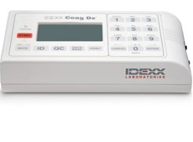
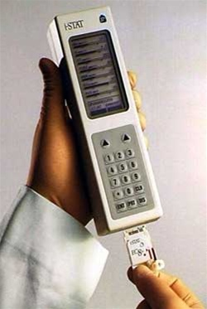
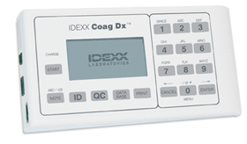
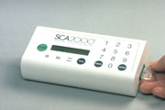
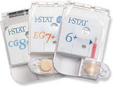
Quick Coagulation Testing

Slide 38
Coagulopathy
Coagulation defects can be categorized as:
  Coagulation defects of primary hemostasis
    Quantitative or qualitative
    Chronic bleeding
    Petechiae, mucosal bleeding, purpura, ecchymoses, epistaxis, melena, prolonged bleeding
  Coagulation defects of secondary hemostasis
    Hemorrhage (e.g. pleural, peritoneal, retroperitoneal)
    Hematoma formation
    Delayed bleeding/rebleeding
  Defects of fibronolysis
    Thrombosis formation

Slide 39
Bleeding disorders (diatheses) may be caused by congenital or acquired defects in coagulation proteins, platelets, or vasculature.
Inherited coagulation defects are usually associated with a single coagulation protein and often occur at a young age.
Acquired coagulation defects often affect multiple coagulation proteins and can occur at any age.

Slide 40
Coagulation Defects of Primary Hemostasis
Thrombocytopenia
  Decreased PLT number
  Can be congenital or acquired
  #1 cause = infectious disease
    Ehrlichia, rickettsial diseases, babesiosis, systemic mycoses, toxoplasmosis, hemobartonellosis, Feline retroviruses (FeLV, FIV, FIP), others
  Other causes = bone marrow depression; unknown
Von Willebrand’s disease (vWd)
  Decreased or deficient vWF= decreased PLT adhesion, aggregation, and fibrin cross linking
  Can occur secondary to hypothyroidism
  CS: MM hemorrhage, hematuria, GI bleeding, epistaxis
  Screening test of choice = BMBT

Slide 41
Qualitative Platelet Dysfunction
Thrombocytopathia
Most common cause is inappropriate use of NSAIDs.
Can also be caused by:
  Myeloproliferative disorders
  Rare congenital problems
  Certain drugs

Slide 42
Thrombocytopathy – Qualitative Platelet Dysfunction
Table 10-3. Drugs Affecting Platelet Function
Anesthetics | General - Halothane
 | Local - Procaine
Antibiotics | Cephalosporins - Cefazolin
 | Penicillins - Ampicillin
Anticoagulants | Heparin
Antihistamines | Chlorpheniramine
Cardiovascular drugs | Propanolol, Verapamil
Foods and food additives | Ethanol, onions
Nonsteroidal anti-inflammatory drugs | Aspirin, Phenylbutazone
Oncologic drugs | Daunorubicin
Plasma expanders | Heta starch, Dextrans
Miscellaneous drugs | Chlorpromazine

Slide 43
Coagulation Defects of Secondary Hemostasis
Congenital clotting factor deficiencies of virtually all known factors have been described. (e.g.: Hemophilia A & B)
Acquired coagulation defects can result from:
  #1 = Rodenticide toxicity
    Inhibits vitamin K
    Vitamin K is required to activate factors II, VII, IX, and X
    One-step prothrombin time = test to confirm warfarin toxicity.
    Liver disease, infiltrative bowel disease, and biliary obstruction can also inhibit Vitamin K

Slide 44
Other Acquired Coagulation Defects of Secondary Hemostasis
Hepatic Disease
  The liver synthesizes many of the clotting factors including factors I, II, V, VII, VIII, IX, X, XI, and XII
  Liver manufacturers bile which is essential in absorption of vitamin K from diet
Disseminated Intravascular Coagulation (DIC)
  A complex syndrome with systemically accelerated coagulation
It is clinically difficult to differentiate between hepatic disease and DIC because PT and PTT are usually prolonged with both.
DIC can occur secondary to hepatic disease.

Slide 45
Disseminated Intravascular Coagulation (DIC)
Not a disease in itself; it is a complex syndrome that results from a pathologic condition.
Involves accelerated activation of platelets, coagulation proteins, and plasmin evolving into consumption of coagulation proteins, platelets, and inhibitors of fibrinolysis
Some of the many pathologic conditions associated with initiation of DIC include:
  Trauma and burns
  Metabolic acidosis/severe shock
  A large number of infectious diseases
  Envenomation
  Systemic infection
  Heartworm disease
  Heatstroke
Sometimes considered an “Idiopathic” condition

Slide 46
DIC
Laboratory findings are highly variable
  Classically ACT, PTT, PT, and thrombin time are prolonged; fibrinogen and platelet counts are decreased
  Schistiocytes seen on smear
Diagnosis is based on clinical suspicion and at least 3 abnormal coagulation test results.
Clinical signs depend on the phase in which the patient is experiencing
  Peracute (hypercoagulable) phase: may have few to no overt clinical signs
  Acute (consumptive) phase: characterized by venipuncture oozing or modest to severe hemorrhage with inability to form a normal clot
  Chronic phase: charactized by no clinical signs or oozing of blood
Death is caused by extensive microthrombosis or circulatory failure, leading to single or multiple organ failure

Slide 47
Treatment of DIC
Successful treatment depends on early detection in critically ill animals.
Involves:
  CORRECTING UNDERLYING PROBLEM
  Support of target organs where microthrombi may cause ischemia or hemorrhage
    Fluid therapy – balanced electrolyte solutions to maintain effective circulating volume
  Coagulation factor replacement therapy
  Administration of heparin as needed (controversial)
    Should be accompanied by administration of plasma
  Close monitoring of antithrombin activity
Prognosis is usually grim; depends on underlying cause
If an animal survives an acute DIC event, a chronic form of DIC can exist

Slide 48
Dysfunctions of Tertiary Hemostasis
The most common dysfunctional state of tertiary hemostasis is excessive fibrinolysis. This is an uncommon disease.
Fibrinolysis failure can also cause thrombus formation (a condition, not a disease state)

